Slide 1
Import JSON
Import JSON

Slide 2
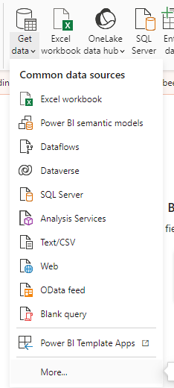
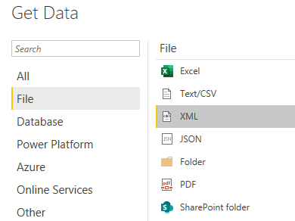
Import JSON
Note: This lab uses the CustomerOrder.json file located in the resources / JsonSources folder .
Select JSON as the data source.
2
1

Slide 3
Import JSON
Open the file Example1.json In the Notepad++ text editor and observe the structure of the .
Note that the element Colors is of type array .
Open the file Example2.json and notice that its structure differs from Example1.json .​​
Open the file Example3.json and observe that its structure is still different from the two files previous .
Open the file Example4.json and see that he presents a similarity with Example2.json , but that its elements represent lists​ rather than values scalars .
Afterwards :
Select JSON as a data source .
Try loading the first file ( Example1.json ) into Power Query and observe that the data are represented in the form of records .​

Slide 4
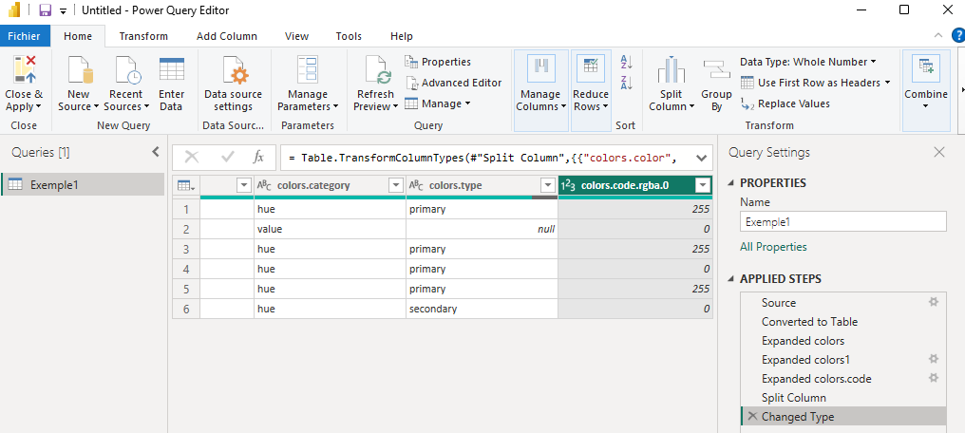
Import JSON
Keep only Source and delete the rest of the steps.

Slide 5
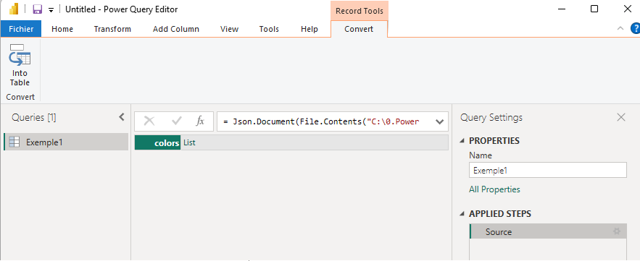


Import JSON
Click Into Table
Click the icon
Expand the list
1
Create each data in a
Separate line
2
Create multiple data in a single line
with separator

Slide 6
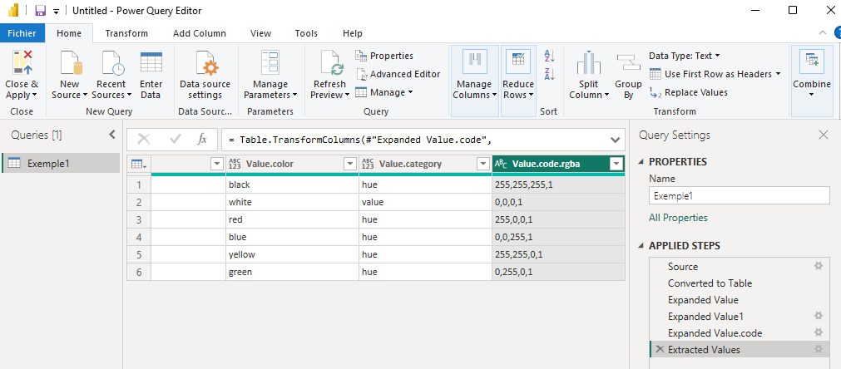
Import JSON
This for example kind of data structure

Slide 7
Thank you
Thank you

